Slide 1
Rola władz lokalnych i regionalnych jako facylitatorów działań na rzecz zero odpadów
Nasze zasoby są policzone!

Slide 2
Publikacje
+/- 90 członków
23 kraje
> 1000 władz
ACR+
Sieć dla władz lokalnych i regionalnych
Konferencje
Webinary
Wiadomości
Notes:
1. Who are we?
International network: EU + Eastern & Southern Mediterranean countries
Around 100 members, covering more than 1000 local authorities
Technical network, help LRAs to find technical solutions; exchange best practices → sustainable resource management
2. What do we do, concretely?
a) Grey arrow: Service to our members: exchange of best practices, publications, weekly newsline, conferences, webinars
b) Blue arrow: Project work
mostly involving members as project partners, all members profit from the sharing of acquired knowlede, & experiences
Internal projects: WG CE, Observatory (European Observatory on municipal waste performances), EPR Club
European projects: Horizon2020 (south Mediterranean cooperation), Regions4Recycling, European Week for Waste Reduction

Slide 3
Od odpadów do zasobów…
Gospodarka liniowa
Resources
Gospodarka powiązań
Gospodarka o obiegu zamkniętym
Zasoby
Downcycling
Upcycling
Sustainable Production
Production
Produkcja
Społeczeństwo odpadów!!!!
Lepiej… ale nie idealnie!!!!
Zamknięty cykl!
Consumption
Sustainable Consumption
Konsumpcja
Waste
Odpady
Od odpadów do zasobów
Notes:
Vision CE: putting our activities in context
Where are we coming from? – Traditional model: Linear economy
Resources get extracted
Production of products
Products get consumed
What is left is considered as waste and is disposed off
→ Throw away society!
Where are we at the moment? – Current model: Chain economy
Resources get extracted
Products get produced and then consumed
What is left is
either considered as waste and disposed off
or it gets downcycled or recycled: Downcycling means the process of converting waste materials or useless products into new materials or products of lesser quality and reduced functionality. It needs to be mentioned here, that for some material streams recycling works pretty well, without having a downcycling effect, such as for glass or paper.
What are we aiming at? – Future model to reach resource efficiency: Circular economy
→ Closing the loop
Sustainable Production, sustainable consumption and upcycling instead of downcycling
Shift of the economic model, includes ideas like shared economy, news business models, eco-design, etc.
Upcycling is the process of converting waste materials or useless products into new materials or products of better quality or for better environmental value.
No or almost no waste is left
Everything that is left is considered as resources, not as waste
What does a “closed loop” system imply?
Increasing the time products deliver their service before coming to the end of their useful life (durability);
Reducing the use of materials that are hazardous or difficult to recycle (substitution);
Creating markets for recycled materials (standards, public procurement);
Designing products that are easier to repair, upgrade, remanufacture of recycle (eco-design);
Incentivising waste reduction and high-quality separation by consumers;
Incentivising separation and collection systems that minimise the costs of recycling and reuse;
Facilitating industrial clusters that exchange by-products to prevent them from becoming wastes (industrial symbiosis);
Encouraging wider consumer choice through renting or leasing instead of owning products (new business models)
POLICY FRAMEWORK
- Design and innovation
- Unlocking investment
- Harnessing the role of business and consumers
MODERNIZING WASTE POLICY AND DIRECTIVES
A RESOURCE EFFICIENT TARGET
1 Design and innovation
Coherent product policy , further developing Ecodesign Directive
Horizon 2020 research and innovative policies: large scale innovation projects…reinforced partnership
2. Unlocking investment
- Innovative financial instruments ( accounting rules, fiduciary duties; resource stress tests, potential of the bonds market )
Guidance on Green Public Procurement
Integration circular economy priorities into European Funds
3 Harnessing the role of business and consumers
- Building on the results of the Environmental Footprint pilot phase, - Broad stakeholder cooperation through coordination and support action under Horizon 2020, action on SMEs and green employment

Slide 4
Podejście od dołu do góry: hierarchia terytorialna
WORLD
EUROPE
NATIONAL
REGIONAL
CITY
NEIGHBOURHOOD
NAJPIERW KRÓTSZY CYKL
Notes:
Part of the CE economy concept is also the idea of a territorial hierarchy: the short cycle always comes first when developing CE measures, ideas, strategies, and the “lower” levels are key for success
neighbourhood first, then city, then region; and only then the nation states, the EU and worldwide level
Without forgetting that 90 % of the European Economy is made by SME’s

Slide 5
Podejście od dołu do góry: rola WLiR
Zachęcaj
Wspieraj
Katalizuj
Zademonstruj
Angażuj

Slide 6
Podejście od dołu do góry: rola WLiR
Usuń bariery dla działań
Wspieraj kluby/ społeczności
Buduj zdolności i własność
Zapewnij miejsce / narzędzia
Dostarcz wiedzy
Wspieraj
Katalizuj
Notes:
Change Ability to act & choose: Design/provide convenient services, support, facilities and equipment
Build capacity & ownership: Recruit groups of residents / local champions, support building of social norms
Develop skills & ability: Support community learning to increase knowledge of options and embed new habits

Slide 7
Podejście od dołu do góry: rola WLiR
Katalizuj
Angażowanie partnerów we współprojektowanie
Fora dyskusyjne i konsultacyjne
Kontakty osobiste + bezpieczne zobowiązania
Wspieranie lokalnych inicjatyw
Celowe kampanie, przekazy i promocje
Kampanie medialne/ wzory / wykorzystanie sieci
Angażuj
Notes:
Engage
Work with residents using co-design and deliberative consultation
Build outreach partners and intermediaries;
build community outreach and action (via talks, events and training);
targeted campaigns, messages and promotions & utilise: social networks, media/opinion formers
Promote ‘enable’, ‘encourage’ and ‘exemplify’

Slide 8
Podejście od dołu do góry: rola WLiR
Zachęcaj
Odnieś się do ‘co w tym jest dla mnie?’
Dostarcz zachęt
Uznaj zasługi, zapewnij równe szanse
Podatki i środki fiskalne
Przepisy i kary
Uznaj status
Katalizuj
Notes:
Encourage
exemplify’
Address ‘what’s in it for me?’
Provide incentives (e.g. subsidies, free or trial equipment, run local competitions)
Provide targeted feedback on positive stories e.g. via ‘lifestyle’ case studies: recognise contribution, ensure level playing field
Say ‘thank you’

Slide 9
Podejście od dołu do góry: rola WLiR
Katalizuj
Rób to, co mówisz i prowadź
Wykaż wspólną odpowiedzialność
Dokonaj przeglądu polityk i zasad pracy z innymi wydziałami
Zazieleń politykę zamówień publicznych
Pilotuj interwencje wśród pracowników
Zademonstruj
Notes:
Exemplify
Demonstrate shared responsibility –you are acting too!
Review internal policies and work with other departments
Engage employees and provide support, services and facilities for your staff
Pilot interventions amongst staff

Slide 10
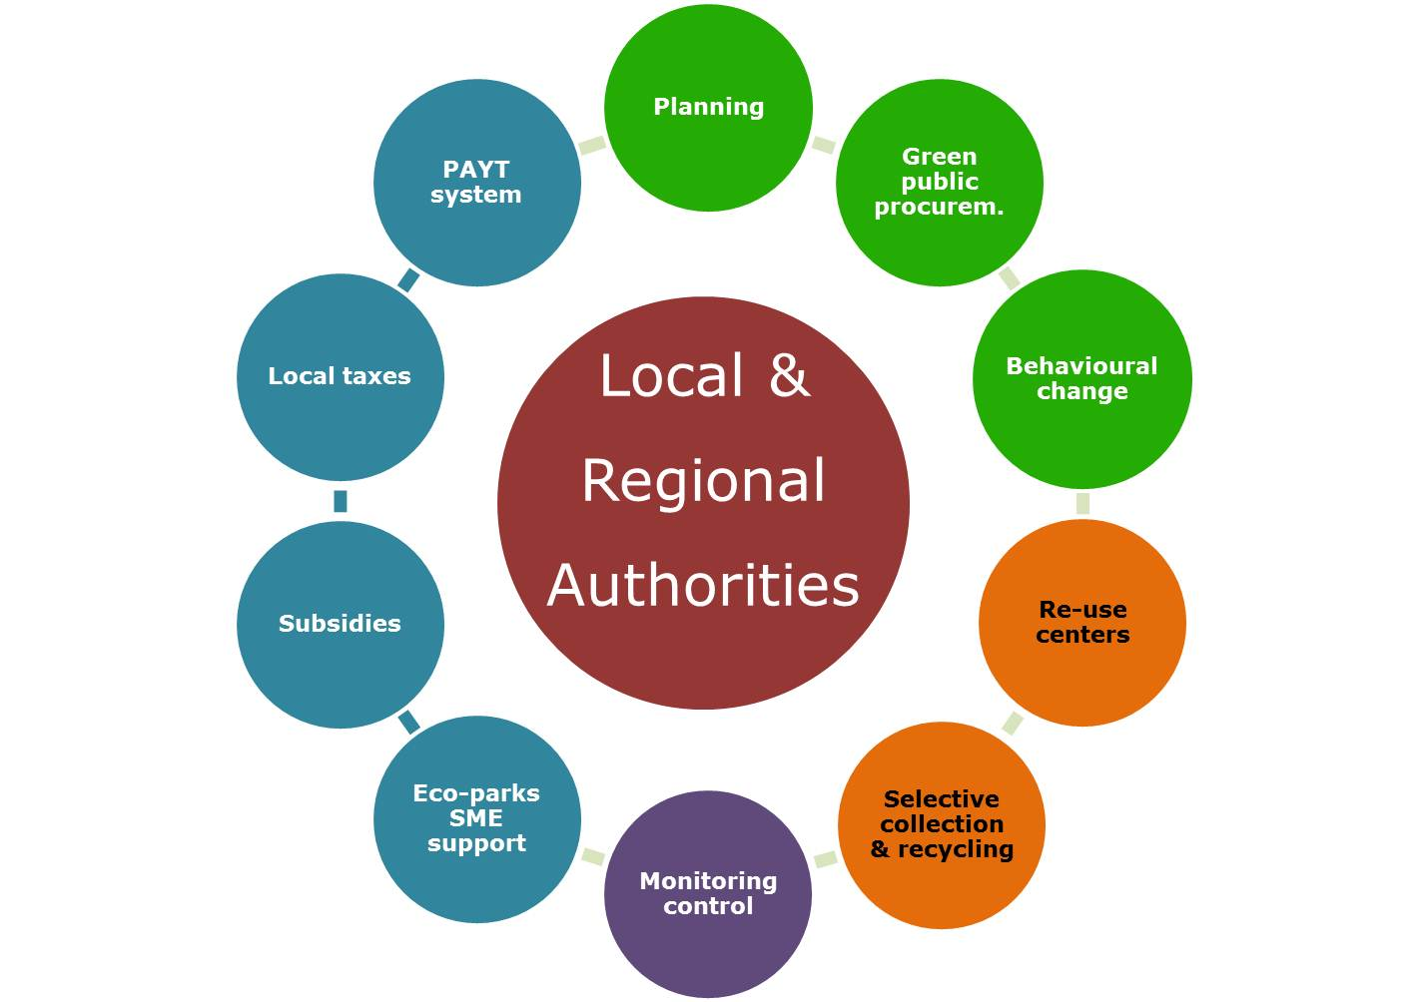
Podejście od dołu do góry: rola WLiR
Planowanie
1
System PZTIW (PAYT)
Zielone zamówienia publiczne
Instrumenty prawne i ekonomiczne
2
3
Podatki lokalne
Zmiana zachowania
Władze lokalne i regionalne
5
4
Subsydia
Centra ponownego użycia
Eko-parki wsparcie MSP
Selektywna zbiórka i recykling
Monitoring
Notes:
Based on the idea of the territorial hierarchy it is already clear that LRAs are key actors on the path to achieve resource efficiency via CE
They act on several levels:
Legal and economic instruments: taxes, subsidies, introduction of PAYT systems, or direct support to eco-parks and related SMEs
Monitoring & control
Waste management: introducing/improving selective collection and recycling, setting up/supporting reuse centers
Strategical & communication instruments:
Planning
Green public procurement
Communication on behavioural change
ACR+ has been working on most of these instruments and measures in order to support LRAs to reach resource efficiency. I would like to pick out four short examples today in order to dig a bit more into the role of LRAs and what ACR+ can offer to support them:
Strategical instrument: Planning – The ACR+ Working Group on Circular Economy
Monitoring & control AND WM: Selective collection & recycling
The ACR+ European Observatory on municipal waste performances
Recent publication “EU Capitals Cities Waste Management Benchmark”
The Regions for Recycling project
Communication instruments: Behavioural change – The European Week for Waste Reduction project

Slide 11
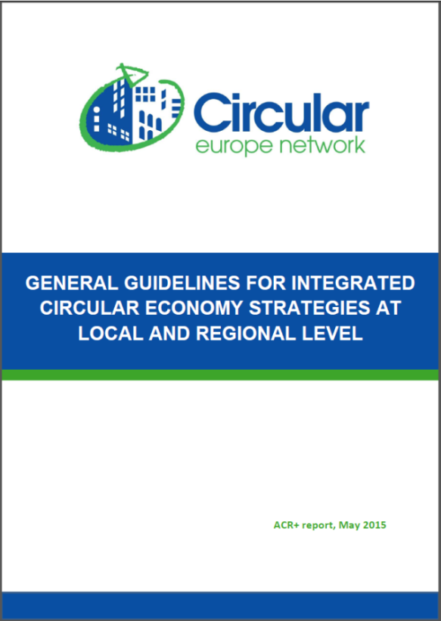
Planowanie
Circular economy
1
Planowanie
Przewodnik ACR+ po planowaniu gospodarki o obiegu zamkniętym (CE)
Objaśnienie CE
Podstawowe pojęcia i cele
Główne zasady strategii CE
Główne obszary interwencji
CE w praktyce
Pierwsze kroki na drodze do CE
Instrumenty, środki międzysektorowe i tematyczne
Mapa drogowa i monitoring
Production
Chcesz wiedzieć więcej?
Contact: pmn@acrplus.org
Philippe Micheaux Naudet, ACR+
Notes:
Table of content
INTRODUCTION
Part 1: CLARIFYING CIRCULAR ECONOMY
1. WHAT DOES “CIRCULAR ECONOMY” MEAN?
1.1. Basic concepts
1.2. Objectives of circular economy
2. ON WHAT PRINCIPLES SHOULD A CIRCULAR ECONOMY STRATEGY BE BASED?
2.1. The “multi-R” hierarchy
2.2. Territorial hierarchy
2.3. Shared governance
2.4. Integrated planning
3. WHAT ARE THE KEY AREAS OF INTERVENTION?
3.1. Material resources management
3.2. Sustainable consumption
3.3. Sustainable production
3.4. Priority sectors
Part 2: CIRCULAR ECONOMY PLANNING IN PRACTICE
4. WHAT (FIRST) FUNDAMENTAL INITIATIVES SHOULD LOCAL AND REGIONAL AUTHORITIES TAKE?
4.1. Develop a cross-sector approach at the political and administrative level
4.2. Identify potential stakeholders
4.3. Identify parallel policy actions in progress or planned
4.4. Establish a diagnosis of the territorial metabolism
4.5. Gather information on experiences from similar territories
4.6. Organise co-creation
5. WHAT INSTRUMENTS TO USE? WHICH TRANSVERSAL AND THEMATIC MEASURES?
5.1. Potential instruments
5.2. Cross-sector measures
5.3. Thematic measures
6. WHAT ROADMAP AND MONITORING TO ADOPT?
CONCLUSIONS

Slide 12
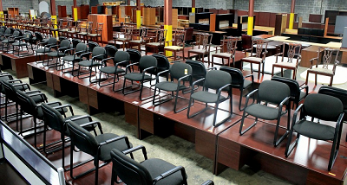
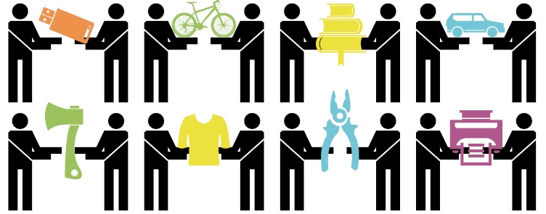
Zielone zamówienia publiczne
2
Zielone zamówienia publiczne
Zamówienia publiczne (= 18% PKB UE):
Wzrost zrównoważonego rozwoju i eko-innowacyjności poprzez zamówienia publiczne
Eko-innowacyjne i trwałe produkty, ponowne użycie, usługi zamiast posiadania dóbr
Rola wzorów
Notes:
Examples (check if members)
Stockholm (Sweden) – for IT equipment
Badalona (Spain) – for school materials
Dunkerque (France) – for recycled paper
Ferrara (Italy) – for organic food in school canteens

Slide 13
Lokalne/regionalne podatki
3
Podatki lokalne
Odejście od składowania i spalania odpadów:
Podatek lub zakaz składowania i spalania odpadów
Ulgi podatkowe dla infrastruktury selektywnej zbiórki i recyklingu
Kampanie podnoszące świadomość społeczeństwa
Notes:
A 2009 European Environment Agency (EEA)11 report suggests that to be effective a landfill tax level should be relatively high, but that public perceptions of the tax burden are arguably as important as the tax rate itself. The example of Estonia is cited, where although the tax rate is low compared with many other MS, and fairly low in the context of Estonian prices, it did increase considerably within a few years, and the rapid increase had the effect of Estonian waste companies and municipalities considering it to be a ‘high’ tax, which had some effect on reducing waste sent to landfill.
Compared 11 Member States: landfill taxes and the decreasing rates of landfill.
The figure shows strong apparent correlations between increasing landfill tax rates and decreasing rates of landfill for MSW in three MS in particular (Austria, Sweden and the UK). In Austria, the ban on landfilling of waste with total organic carbon (TOC) content over 5%, and waste exceeding the 7mg O2 / g d.m., came into effect in 2004 (with exemptions until 2008); this is particularly relevant to MSW, hence the strong decline in the rate of MSW landfilled from 2004 onwards.
In four other MS (Denmark, Estonia, Finland and the Netherlands), some slight apparent correlation can be observed.
In a further four MS (France, Ireland, Latvia and Poland), however, there is no distinguishable correlation between changes in the rate of landfill tax and the amount of MSW sent to landfill (which does not mean that this might not happen in future). However, it must be stressed that there will have been other factors at play, including broader waste policy in the MS (including the financing provided for different waste treatment infrastructures), the use of other EIs in the waste sector, the economic situation over time, changes in the gate fees charged by landfill sites (which may vary for reasons such as market conditions or changing technical or environmental standards), the available capacity of landfills and so on.
Therefore we must be very wary, even where there are strong apparent correlations between the level of landfill tax and the amount of waste sent to landfill, of inferring direct correlations between the two factors. Equally, we should not assume that the apparent absence of an effect does not mean there has been no influence exerted by the tax.

Slide 14
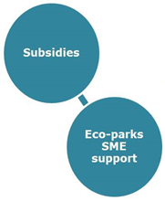
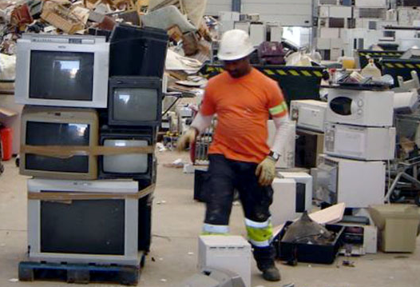
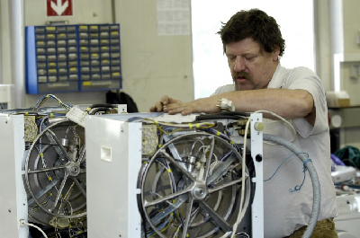
Subsydia i pomoc finansowa
4
Subsydia
Subsydia i pomoc finansowa dla eko-parków i MSP
Warsztaty naprawcze
Centra ponownego użycia
Centra recyklingu
Eko-parki wsparcie MSP
Notes:
Examples (check for members)
FLEMISH REGION : Network KOMOSIE - Kringwinkels
BARCELONA PROVINCIA : ANDROMINES - (Deixalleria and Re-use Center)
BESANCON : IT REUSE
GOTEBORG : ALELYCKAN - reuse park
MUNICH / VIENNA : Repair Networks
Examples IS (check for members)
Kalundborg (DK) :« Kalundborg Symbiosis »
Nord-Pas-de Calais (F) :ECOPAL network
Terneuzen (NL) ( « biopark »)
Sutton district (UK) (« one planet living »)
Sicilia (It) and Northen Ireland ( « Symbiosis » program )

Slide 15
Podnoszenie świadomości społecznej
5
Zmiana zachowania
© theskinographies.com
© Akademia

Slide 16
Podnoszenie świadomości społecznej
5
Zmiana zachowania
Działania podnoszące świadomość, jak zapobiegać odpadom, możliwości ponownego wykorzystania produktów i recyklingu materiałowego
Dla mieszkańców Europy
~ 12 000 działań w 2014
Idee, wskazówki i metodologie
Nagrody wyróżniające najlepsze działania
Dni Tematyczne poświęcone zapobieganiu odpadom 2015: Dematerializacja – Robiąc więcej z mniej!
Zaangażowanie na różnych poziomach
Program LIFE+, Partnerstwo Europejskie, Sekretariat techniczny (ACR+)
Narodowi, regionalni i lokalni koordynatorzy
Posprzątajmy Europę (Let’s Clean Up Europe): następna edycja 6-8 maja 2016
www.ewwr.eu and

Slide 17
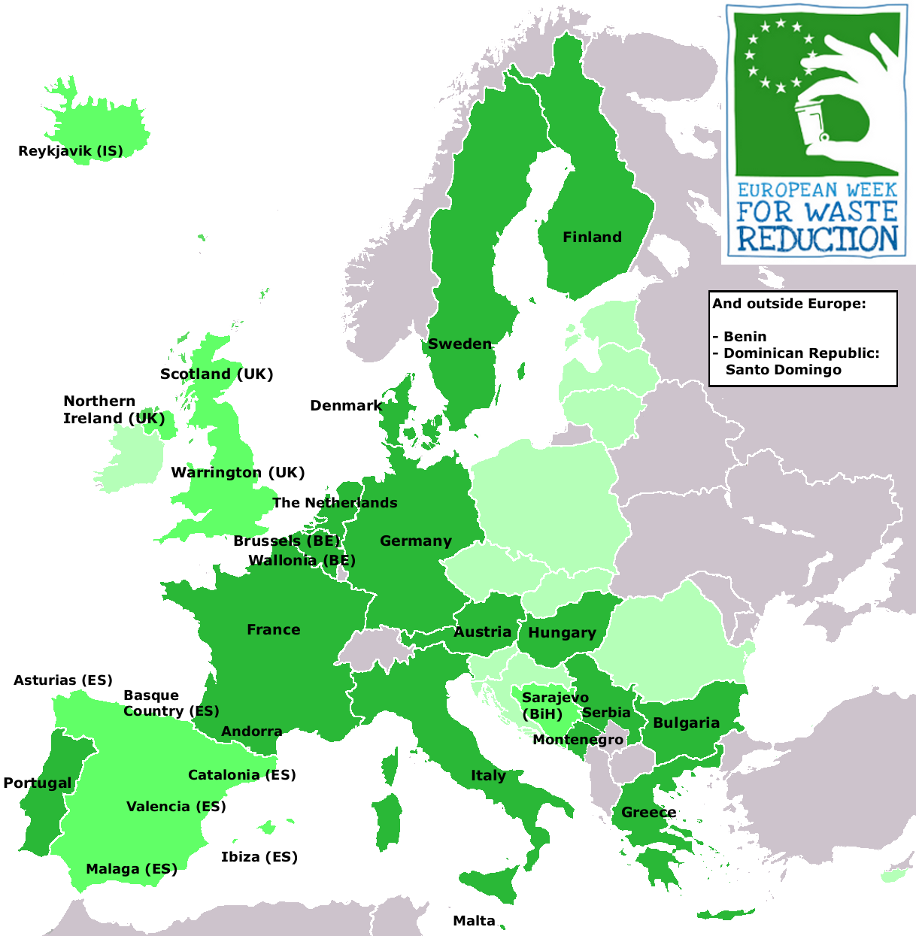
Podnoszenie świadomości społecznej: EWWR 2014
5
Zmiana zachowania
11.993 działań
20 krajów
34 koordynatorów EWWR

Slide 18
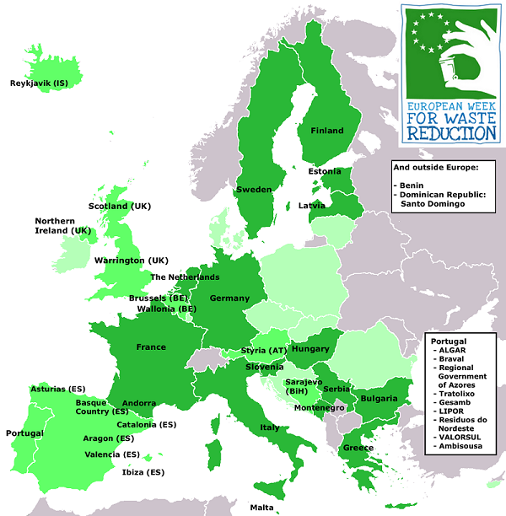
Pomóż nam wypełnić lukę!
5
Zmiana zachowania
WEŹ UDZIAŁ!
21-29 LISTOPAD 2015 !

Slide 19
Rola WLiR jako facylitatorów
Planowanie
System PZTIW (PAYT)
Zielone zamówienia publiczne
Zachęcaj
Wspieraj
Podatki lokalne
Zmiana zachowania
Władze lokalne i regionalne
Katalizuj
Subsydia
Centra ponownego użycia
Demonstruj
Angażuj
Eko-parki wsparcie MSP
Selektywna zbiórka i recykling
Monitoring

Slide 20
Dziękuję!
www.acrplus.org
Contact: ll@acrplus.org
Lisa Labriga, ACR+

